Slide 1
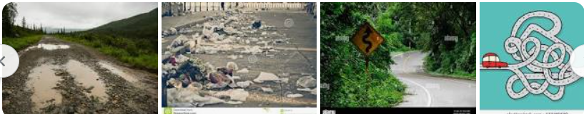
FINAL PROJECT - SNEAKY score Unknown world – is the new world? Have you ever wondered what totally unrelated data might do when you run your machine learning program?

Slide 2
FINAL PROJECT Roadmap SNEAKY sCORE
Week 1
Week 2
Week 3
Week 4
MILESTONE
MILESTONE
MILESTONE
MILESTONE
Gathering Data
Clean Data
Choose Model
Fit into the model
Create a Web page
Create Pipe-line
Scheme User input
Put all together
Run as a whole
Create presentation

Slide 3
FINAL PROJECT Roadmap SNEAKY score
WEEK 1
Model Mockup
Import/export Data
WEEK 2
Train a Model
Working with Data
D1
D2
D3
D4
D1
D2
D3
D4
MILESTONE
MILESTONE
MILESTONE
MILESTONE
MILESTONE
MILESTONE
MILESTONE
MILESTONE
Select topic
Reason
Describe the source data
Technology
Tools and algos
Basic Analysis
Create a branch
Necessary Data analysis
Images (at least 3)
ReadMe
Link to Google Slide Presentation
Desc of Data processing
Feature engineering
Feature selection
Testing sets
Model Mockup
Importing data
Exporting data
Write procedures
Create images
Train a model
Working with data (database)
Collect real data
Clean as necessary
Determine the database to use
Stored the cleaned data
Test it with sample models
Create images
Create presentation materials
Write description of work so far

Slide 4
FINAL PROJECT Roadmap SNEAKY score
WEELK 3
Machine Learning Model
Create images /diagrams
Database interactions
WEEK 4
Design Presentation
Dashboard
Interactive Elements
D1
D2
D3
D4
D1
D2
D3
D4
MILESTONE
MILESTONE
MILESTONE
MILESTONE
MILESTONE
MILESTONE
MILESTONE
MILESTONE
Data
Static data
Drivers /Vehicles
Join to get Vehicles
Use real data
Gather the results from the models
Think of the efficiency
Think of optimization analyzing the results
Run a model
Choose a final model to present
Gather images of testing results
Description of data processing
Feature engineering
Feature selection
How data was split
Training
Testing sets
Model Choice
Benefit of model
Changes Occur in process
How the model was trained
Confusion Matrix
Accuracy Score

Slide 5

FINAL PROJECT – SNEAKY score Which way to cross? Any obstacles? How to handle the obstacles?

Slide 6
FINAL PROJECT Roadmap SNEAKY sCORE
Predicting the Credit Score with Machine Learning
Aim: to predict the outcome of the Credit score of the car owner
Method:
Use data from Car Insurance Company to model outcome of certain pairing between Cars and Credit Scores, given its rank, points, and weighted point differences of the history the given data
Use this model to predict the new unknow input from the user
Data
Vehicles between 2010 ~ 2023 – Resourced from HLDI data service
Drivers owns the vehicle 2010 – 2023 Randomly selected over 1 million data
AGE, CREDIT SCORE, VEHICLE OWNED, GENDER is selected as a feature
NULL, NA, and group count < 1000 is dropped
Convert categorical values to predictable values using Dummy function
Ran K-Means to determine the K.
Trend

Slide 7
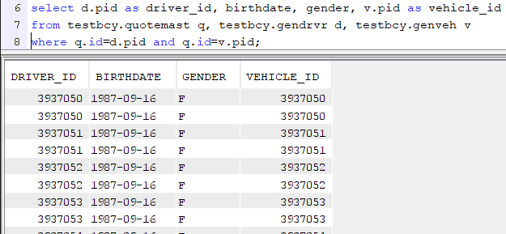
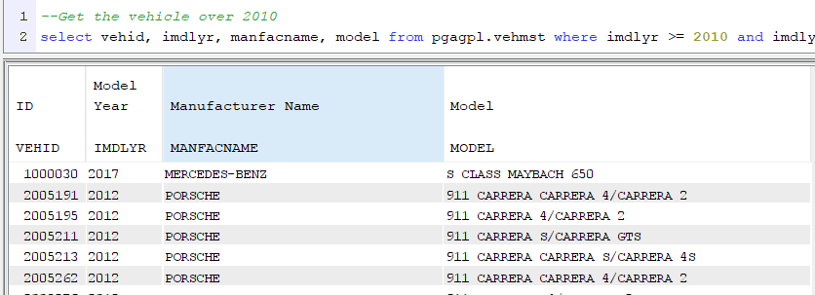
FINAL PROJECT RoaD Crossing SNEAKY score
Drivers Table
From DB2
Vehicles Table
From DB2
Raw Data from Insurance company

Slide 8
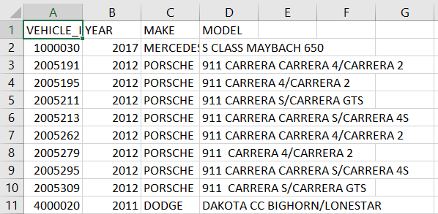
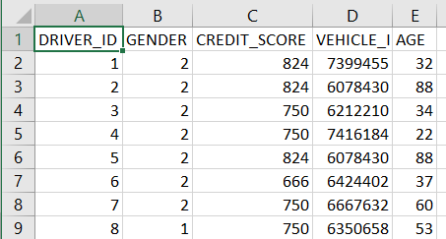
FINAL PROJECT Road Crossing SNEAKY Score
Drivers Table
Vehicles Table
Cleaned/Converted Data
Re-indexed driver’s identification
Removed hidden space issues with column names (nature of migration)
Renamed columns for consistency
Renamed columns easy to read
Converted gender to numeric
Calculated age from Birth Date
Removed the default Credit Score

Slide 9
FINAL PROJECT Road Crossing SNEAKY score
Creating Dummy Variables
Why needed Dummy Variables?
Dummy variables are useful because they enable us to use a single regression equation to represent multiple groups.
We don’t need to write out separate equation models for each subgroup
It is more flexible and allows multiple comparisons to be made
Used when categorical variables to covert as predictor variables
Dummy count should be K-1 (Omit the most common appeared value)
Additional changes :
Filter the most used MAKE
Create a table name “Vehicle_keep.csv” which will be used filtering Driver’s data to keep only drivers who owns the popular cars (1048575 rows reduced to 263310 rows)
Make dummyfied /Model dummyfied (60 to 16 MAKEs and 4395 to 126 MODELs)
Dropped temporary used columns kept only ones will be used.

Slide 10
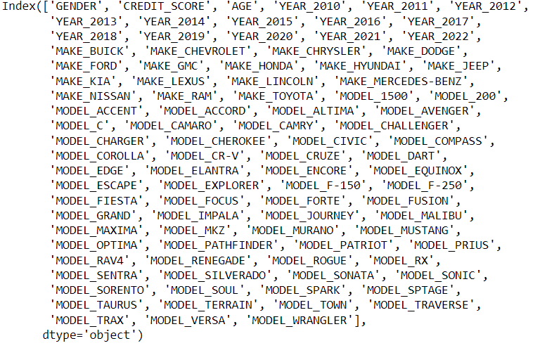
FINAL PROJECT Road crossing SNEAKY score
Creating Dummy Variables
Additional changes (continue)
Year dummyfied (total 12 columns created)
Make dummyfied(total 15 columns created)
Model dummyfied(total 61 columns create, further abbreviated to reduce it to 61)

Slide 11
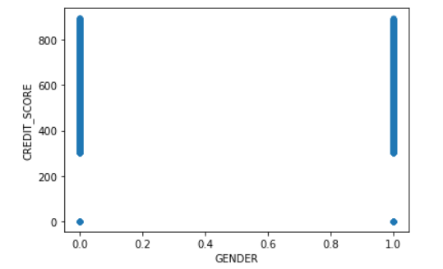
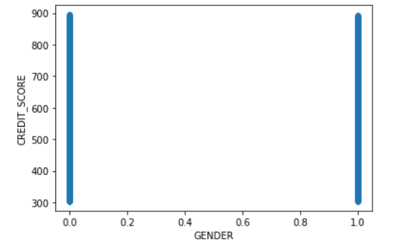
FINAL PROJECT Road crossing SNEAKY score
Removing Outliers
Gender vs Credit Original
Removed the Zeros
Some outliers are problematic and should be removed because they represent measurement errors, Data entry or processing errors, or poor sampling

Slide 12
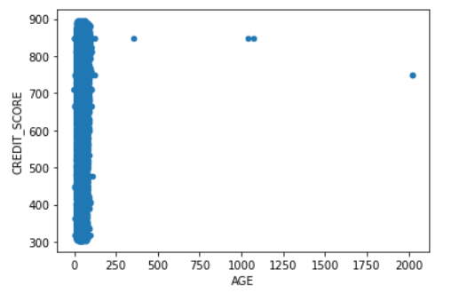
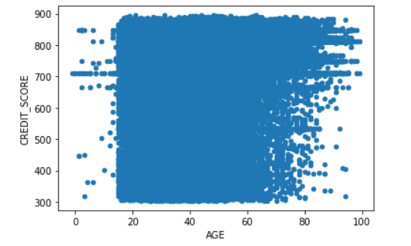
FINAL PROJECT Road crossing SNEAKY score
Data Analysis continued
Age vs Credit
Age < 100

Slide 13
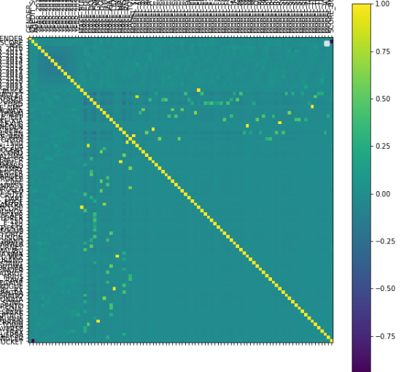
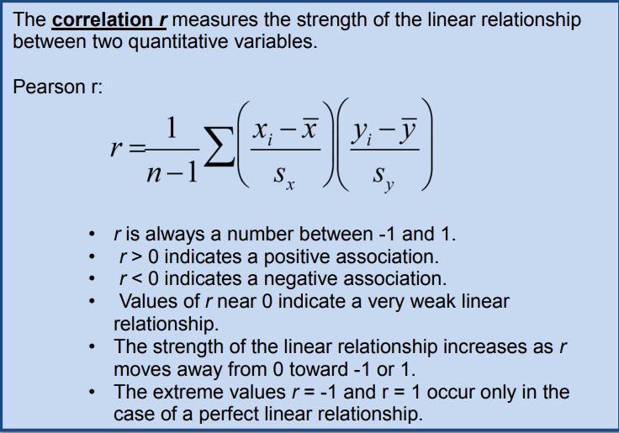
FINAL PROJECT Road Crossing SNEAKY score Correlation plot
A correlation coefficient measures the strength of that relationship (The geen dots can be representing moderate relationship r = 0.5 < r <0.7)

Slide 14
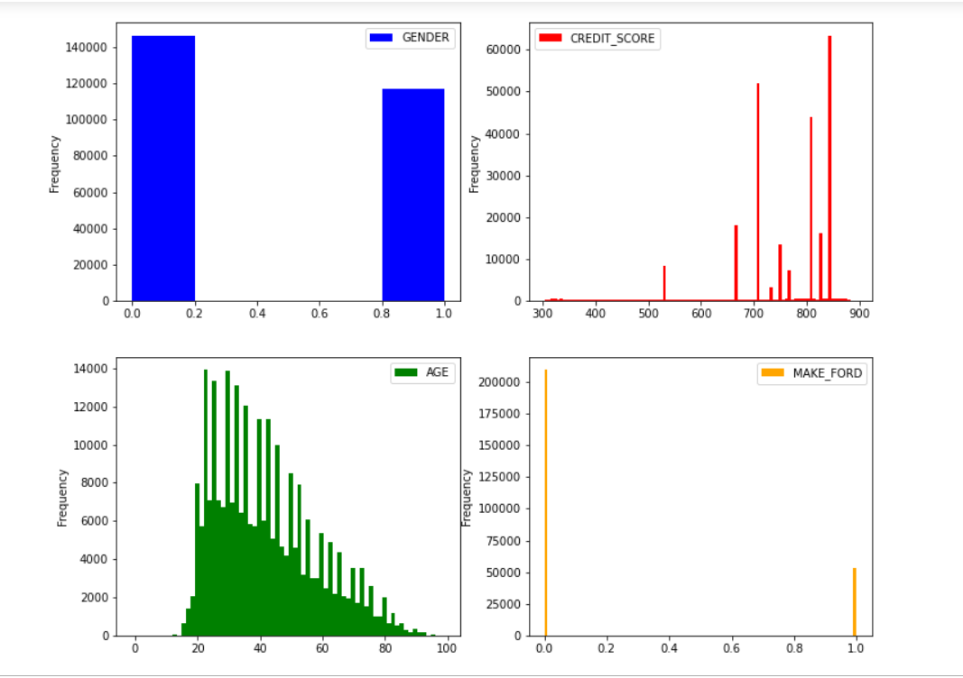
FINAL PROJECT Road crossing SNEAKY score
Population diagram (example FORD)
Male population is slightly higher than female population
Credit Score is concentrated between 670 to 850
Age is between 18 to 80
About 50,000 sample for FORD

Slide 15
FINAL PROJECT Road crossing SNEAKY score
K-means clustering
Why K-means?
The most popular clustering algorithm in existence
It’s relatively simple, intuitive, and easy to conceptualize some Machine learning concepts
Choosing K can be done either intuitively, the Silhouette method, the Elbow method
Elbow Method is selected
How it works?
Once K (any random number) is determined we select K random points from out dataset and use these points as centroids.
Compute the cost function of the distance from the centroid
Choose closest and move the centroid to the point
Repeat computing cost function of the distance / moving the centroid until centroid is no longer change
The ideal number of cluster is obtained when the addition of new cluster doesn't significantly increases the cost function

Slide 16
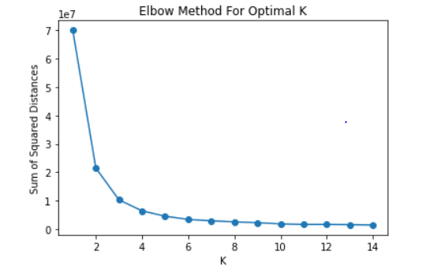
FINAL PROJECT Road crossing SNEAKY score
K-means clustering (Cont)
Apply the Elbow Method using Sum Squared Distances
In order to calculate K means given range of 1 ~15, calculate each distance for n_cluster K
Deter

Slide 17
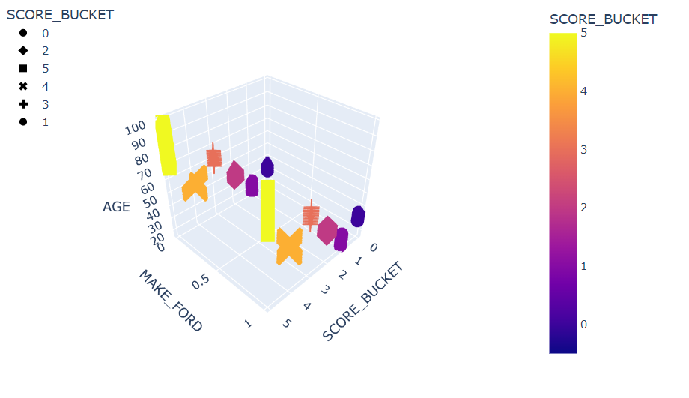
FINAL PROJECT Road crossing SNEAKY score
K-means clustering (Cont)
Scored bucket showing nicely clustered scores
An Example for Ford vs. age

Slide 18
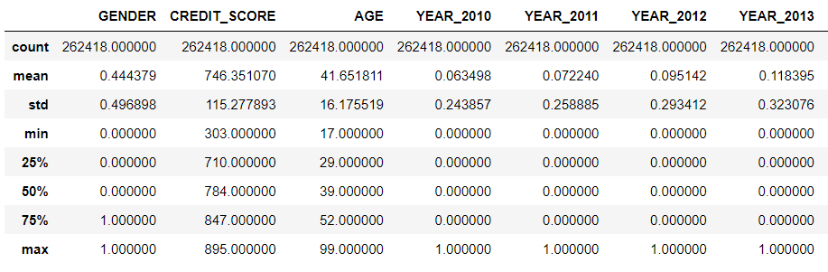
FINAL PROJECT Road crossing SNEAKY score
Modeling
Quickly look at the data Statistics

Slide 19
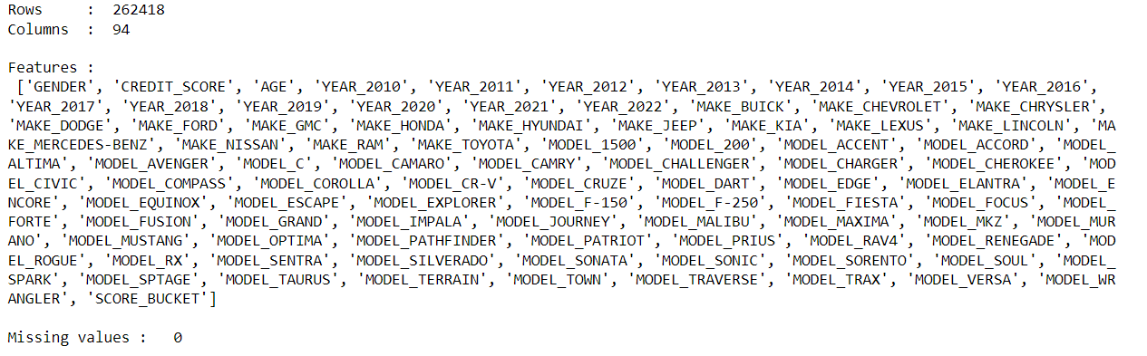
FINAL PROJECT Road crossing SNEAKY score
Modeling
Quickly look at the features
Here, the Score is the R2 Score, which varies between 0 and 100%. It is the proportion of the variance in the dependent variable that is predictable from the independent variables: calculated ( total variance explained by the model) / total variance. Basically, the correlation between test and predicted values.

Slide 20
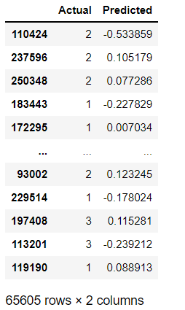
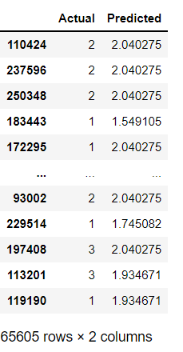
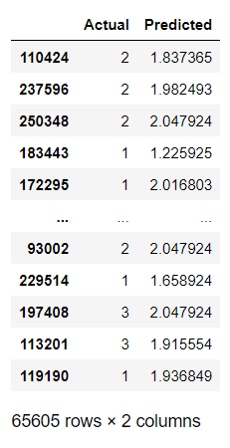
FINAL PROJECT Road crossing SNEAKY score
Comparing Models
Muti-linear
Decision Tree
RandomForest

Slide 21
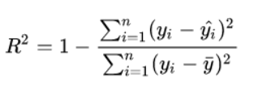
FINAL PROJECT Road crossing SNEAKY score
Modeling
List of Models to Consider - note mentioned :
Linear Regression
Decision Tree Regressor
Random Forest Regressor – slow training, but reasonable
Support Vector Regressor (SVR) – slow training – Omitted while testing
Compared output:
Accuracy: R Squared is one minus the sum of a predictor of the i-th observation divided by the sum of the mean of all observations
RMSE: Root-mean-Square Error (explain next page)
10-Fold Score: ten-ford cross-validation (also explain next page)
NOTE: SVR is omitted since it was taking so long because SVMs are based around a Kernel Method. Most implementations explicitly store this as an NxN matrix of distances between the training points to avoid computing entries over and over again.

Slide 22
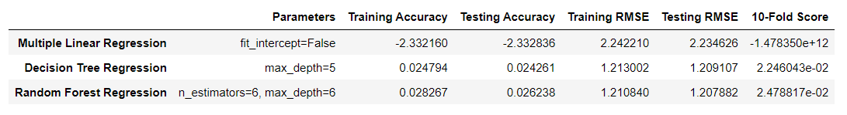
FINAL PROJECT Road crossing SNEAKY score
Modeling
List of Models to Compared Results:
RMSE: Root-mean-Square Error is the standard deviation of the residuals (prediction errors), residuals measure how far from the regression line data points are, and RMSE is a measure of how to spread out these residuals are
10-Fold Score: Ten times ten-ford cross-validation (CV) is one of the techniques used to test the effectiveness of machine learning models. It is also a re-sampling procedure used to evaluate a model if we have a limited data
Decision: Both Decision Tree Regression and Random Forest Regression came out Training Testing perfectly ( I am not sure if it was possible, which means probably our data isn’t a good data set) however, Basic Linear testing earlier gave me about 70% accuracy, and Multiple Linear Regression isn’t shown a positive number in accuracy, a lot of Error rates, therefore the Decision Tree is the best, and it is our choice

Slide 23

FINAL PROJECT – SNEAKY score What is the cause of all this? How do I present it? Do you see the destination?

Slide 24
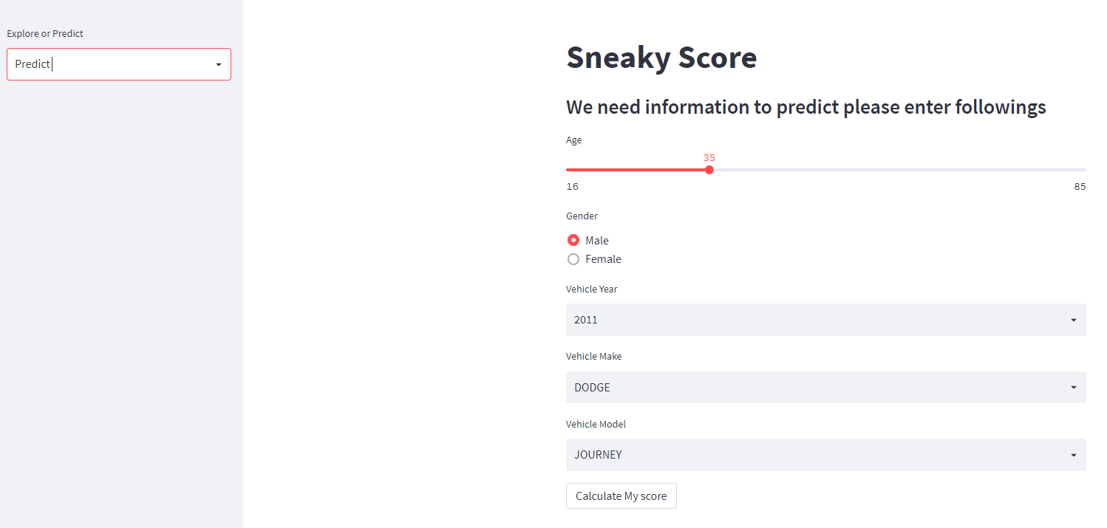
FINAL PROJECT Show off SNEAKY score
Presenting
The Score using StreamLit - Demo

Slide 25
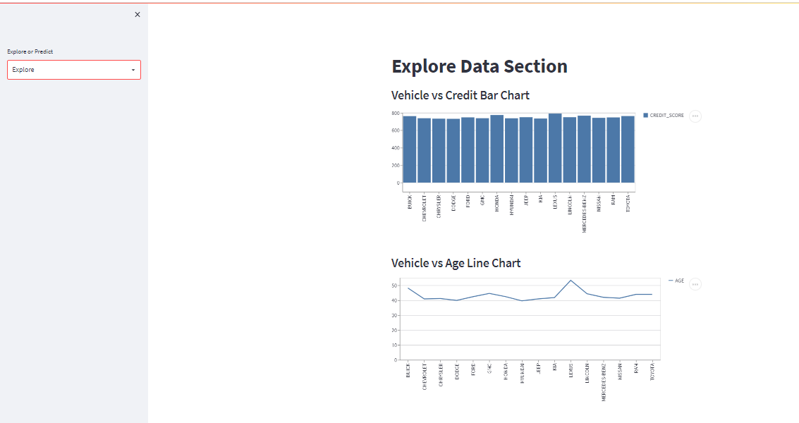
FINAL PROJECT Show off SNEAKY score
Presenting
The Score using StreamLit

